Slide 1
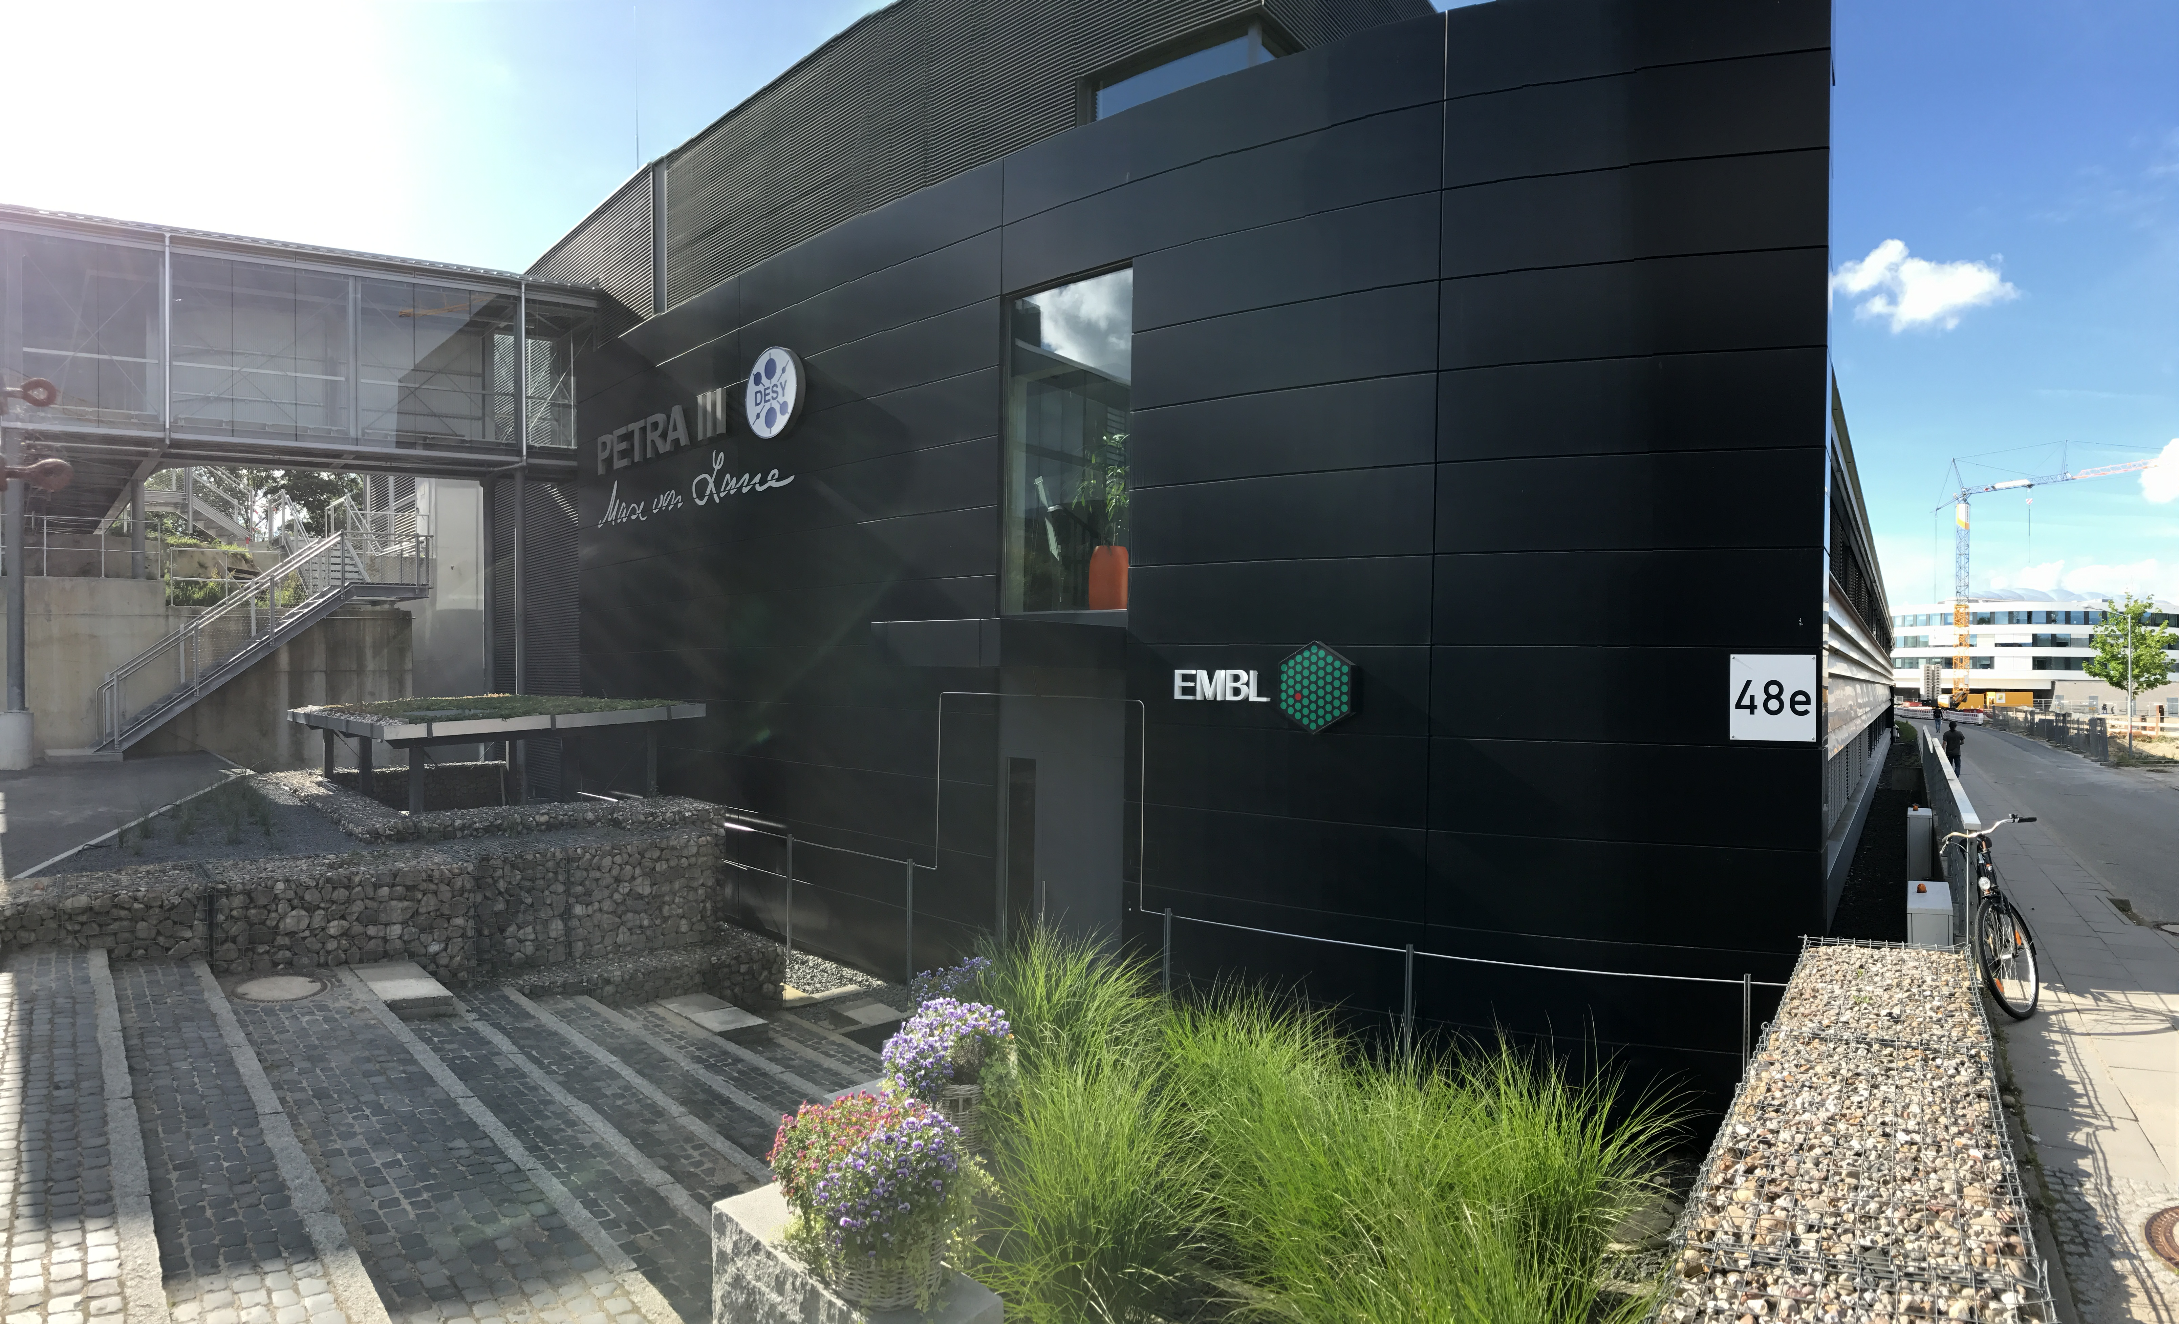
Biological and chemical safety briefing for users at EMBL beamlines and associated laboratories

Slide 2
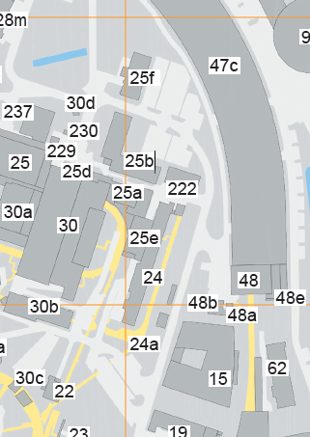
Scope of this safety briefing
This presentation outlines the main safety
regulations for EMBL beamline users and
visitors working in the:
  i) User laboratory in building 47c (L048
  ground floor, PETRA III).
  ii) EMBL laboratories in building 48e and
  building 15: the Sample Preparation and
  Characterisation and High-Throughput
  Crystallisation facility (SPC & HTX facility).
A printed version of the complete Safety Policy
for the EMBL Hamburg unit is available for
consultation in the SPC facility.
User lab
SPC & HTX
facility

Slide 3
Beamline user access - Overview
Full access is available to users in buildings 15, 47c and 48e, which includes:
  Protein characterisation laboratory (01.228, 1st floor, North Wing, CSSB)
  Main user lab (L048).
  P12, P13 and P14 beamlines (PETRA hall).
  SPC cold room (L007) for sample storage and small-scale centrifugation.
  SPC kitchen (L003) for the ice machine and solution/buffer filtration.
  Storage/coat lockers outside the cold room.
  Lab coats outside of the SPC laboratory (L002).
All other facilities must be reserved by contacting the SPC team
TWO WEEKS IN ADVANCE.

Slide 4
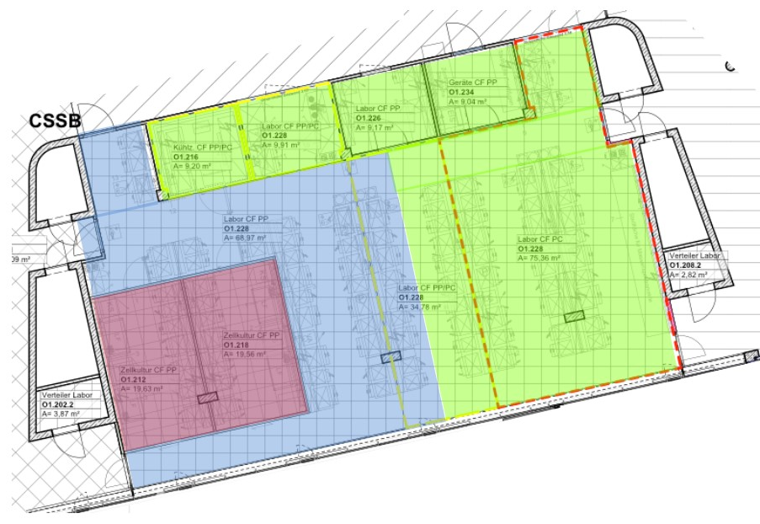
Access for user groups
Molecular Biophysics facility (CSSB)
Full access
Reservation required
Restricted access
Instruments must be reserved by contacting the SPC team
TWO WEEKS IN ADVANCE.
Cell culture laboratory
Protein characterisation facility
(O1.228)
Protein production laboratory

Slide 5
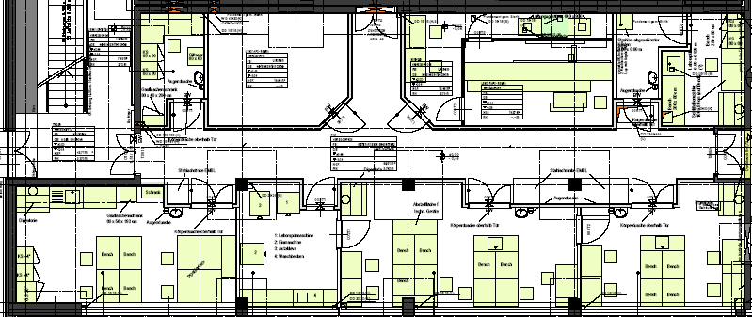
Access for user groups
SPC facility (48e) and User Lab
EMBL beamlines
Full access
Reservation required
Cold room
(L007)
-80 C Freezer
P12 control hutch
Crystal storage
room (L008)
Restricted access
Crystal storage
(L006a)
Derivative laboratory
(L005)
Crystallisation facility
(L004)
Laboratory kitchen (L003)
SPC
laboratory (L002)
MX User lab (L048)
SAXS User lab (L048)

Slide 6
Additional SPC resources
  Access to laboratory chemicals (no chemical storage in the user lab).
  FPLC.
  SDS-PAGE.
  Circular dichroism spectropolarimetry (CD).
  Ultra-centrifugation.
  Thermofluor stability assays.
  Dynamic light scattering (also freely available in the user lab).
  Sample crystallisation screening.
  Dynamic light scattering (Wyatt)
  VP-ITC (Microcal / GE Healthcare)
  MicroCal PEAQ-ITC
  ThermoFluor (MyIQ BioRad)
  Chirascan CD spectrometer (AppliedPhotophysics)
  Nanodrop 2000 (ThermoScientific)
  Nanodrop 2000 (ThermoScientific)
  DynaPro Nanostar (Wyatt)
  SPR T200 (GE Healthcare)
  Prometheus NT.48 nanoDSF (Nanotemper)
  MST NT.115 and LabelFree (Nanotemper)
  Octet Red96 System (Pall ForteBio)
  MALDI-TOF (Bruker system with additional Covalex detector)
  Biomek 4000 Automated Workstation
  Evolution 350 UV-Vis Spectrophotometer
  VERTEX 70v FTIR Spectrometer
  TECAN Spark 20M multimode plate reader
  SX20 Stopped-Flow Spectrometer
  SURFER N1 transporter
  To reserve the SPC facility, send an email to spc@embl-hamburg.de.

Slide 7






Basic safety requirements
Familiarise yourself with the location of the closest first aid kit, fire extinguisher, safety shower, emergency eye wash, escape routes and the emergency exits.
SPC Facility (building 48e) and User Lab (building 47c)
window
window
window
window
window
window
window

Slide 8
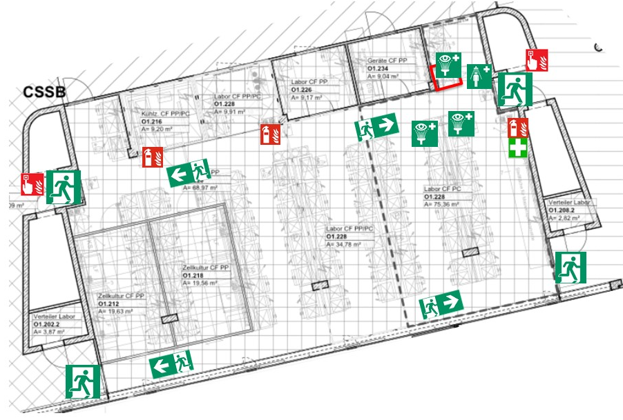
Basic safety requirements
Molecular Biophysics Facility (CSSB)

Slide 9
Basic safety requirements
Do not block or impede access to stairways, emergency exits or escape routes with clutter, garbage or slipping hazards (e.g. melting ice).
Fire doors must remain closed.
Close the windows and doors of the laboratories prior to leaving.
Do not endanger yourself or others at any time.
Emergency escape
route sign
Emergency exit
sign

Slide 10
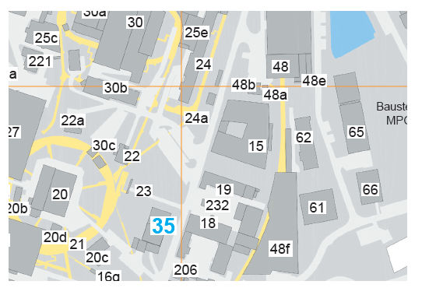

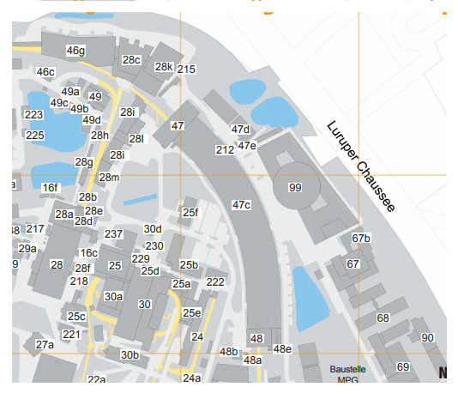
Basic safety requirements
Locations of emergency meeting points:
In the event of a fire:
  Alert others
    Activate the nearest fire alarm
    Call the DESY emergency services.
    Tel.: 2500. They will inform the fire brigade.
  Evacuate the building
    Follow the emergency exit signs and proceed to the meeting point.
    Don’t use the elevator – danger of power failure.
    Help anyone in danger.
    Close doors.
  Try to extinguish the fire
    Use a fire extinguisher if possible. You should not put yourself in any danger.
For building 15: next to building 30c
For building 48e: in front of the FLASH hall, at the end of the PETRA III hall

Slide 11
Medical emergencies / Accidents
In the event of a serious accident:
  Report the accident immediately: call the DESY emergency services (tel: 2500) using a phone in the SPC facility or at the beamlines.
  Secure the area and administer first aid to any injured people.
First aid kits are available. Please inform a member of staff if you use any items so that they can be replaced.
First aid helpers are identified on the door of each floor.
  Report any accident in or around the laboratories to your local beamline contact or a member of staff in the SPC facility so we can record the incident and follow up.

Slide 12




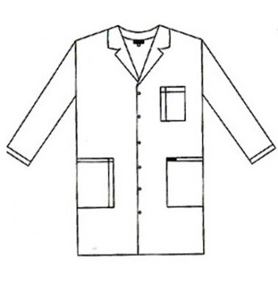

Laboratory safety rules
Coats, bags and luggage must be stored in the lockers available in the main corridor in building 48e.
Wear closed shoes.
Lab coats are mandatory when working in the laboratories and are available in the hall cupboards outside L002. Lab coats should be removed before entering the beamline hutches of PETRA III.
✔
Working at night? For your own safety, you are allowed to work alone at night or at weekends only if you have informed your local contact and organised after-hours access.

Slide 13
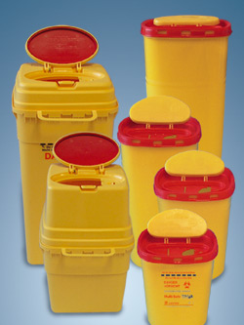
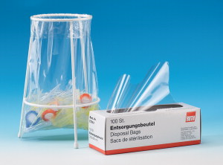
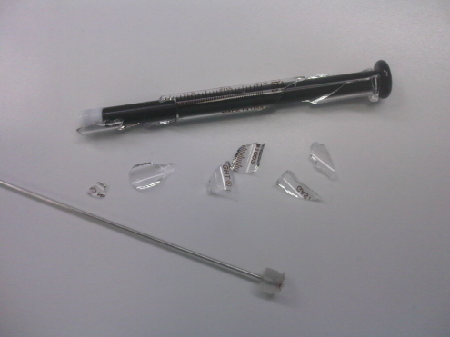
Laboratory safety rules
Sharp objects must be discarded into multi-safe boxes. Needles must NOT be recapped.
Broken glass and glass containers are disposed of in the designated containers in the laboratory kitchen (L003) or in the protein characterisation lab (01.228). For small items (cover slips, capillaries), use the container in the user lab or for sharp items, use the multi-safe boxes.
Pipette tips are disposed of in pipette trash bags available on the laboratory bench.
Plastic containers are disposed of in the general waste bin.
Expectant mothers should contact Maria Garcia Alai regarding specific safety information for their visit - m.garcia@embl-hamburg.de.
Sharps
Pipette Trash
Broken Glass

Slide 14








Chemical safety
You should know and understand these chemical / safety risk symbols:
Flammable
Oxidising
Explosive
Compressed gas
Corrosive
Harmful
Health hazard
Toxic
Warning of
laser beams
Warning of biohazard
Warning of magnetic field
Warning of
electric current
Warning of radioactive matter or ionising rays

Slide 15
Chemical safety
Understand the risks and inform us about potential hazards!
You should know and understand the
risks associated with the chemical and have read
all relevant Material Safety Data Sheets (MSDS).
Information can also be found on the Toxolution electronic registry (http://hd-toxo01.embl.de/Pages/Substanzliste_En.aspx) which you can access during your visit.
Advise a staff member or your local contact prior to an experiment if potentially hazardous chemicals will be used.
Dispose of your chemicals appropriately into the designated waste containers located in the SPC or user laboratory fume hoods. If in doubt, please ask a staff member before discarding solvents.
Label all of your samples and containers with your name and the content, please dispose of them after your experiment.

Slide 16

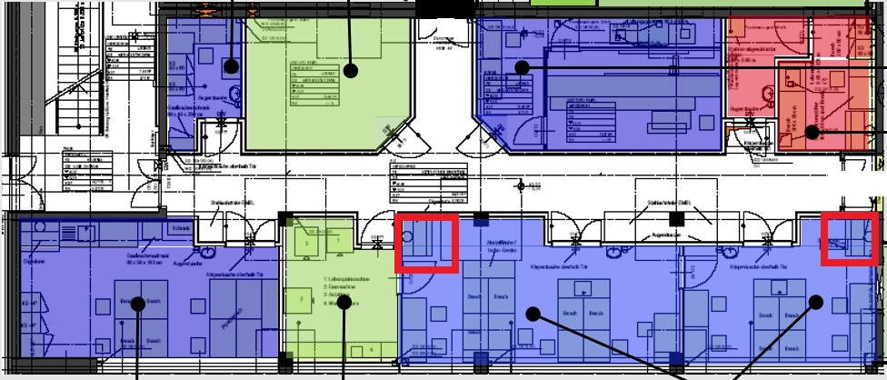
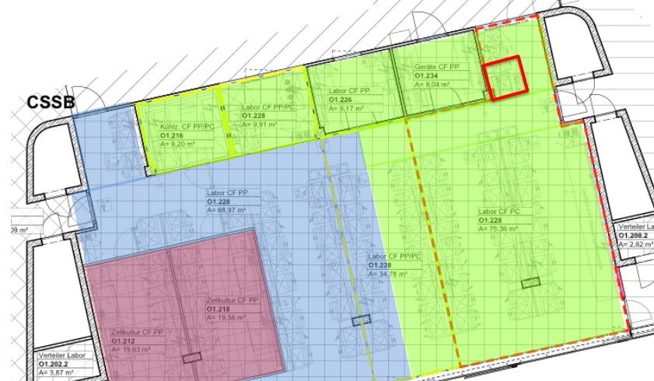

Chemical safety
Safety goggles must be worn and fume hoods must be
used when handling potentially hazardous chemicals.
Building 48e, ground floor Building 15, 1st floor
Depending on the hazard, appropriate gloves must be worn.
Gloves must be removed before touching handles, switches,
taps or leaving the laboratory, and must not be reused.
You should follow the "one-glove" rule: Wear one glove to carry potentially harmful material and have one hand without a glove to touch door handles, switches, etc.
Fume hoods can be found
in several locations in the SPC facility (outlined in red).

Slide 17

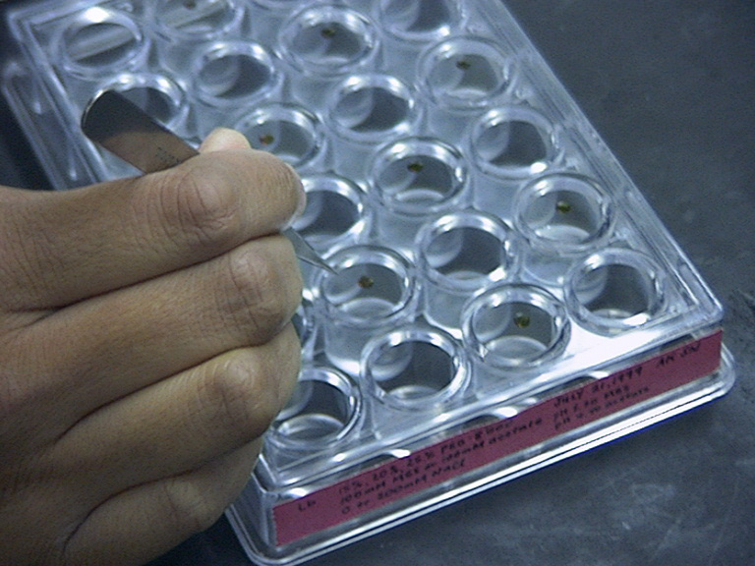
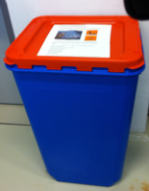
Chemical safety
Dispose of the dried-up crystallisation plates containing any chemicals that are toxic or harmful for the environment in the designated container in the crystal storage room (L008).
Discarding tubes (eppies or falcons) containing liquid into the container is not allowed!
Plates that are free of hazardous chemicals may be placed in the regular waste.
Examples of hazardous chemicals frequently used in crystallisation:
heavy atom salts for phasing
cacodylate buffer
cadmium chloride
lithium nitrate
nickel(II)chloride
potassium iodide
zinc sulphate

Slide 18
Highly toxic and heavy-metal compounds
Radioactive materials are not allowed in the laboratories.
Toxic substances (e.g. hydrofluoric acid) are not allowed in the laboratories.
Do not dispose of dangerous chemicals in the sink.
Users must not manipulate heavy-metal containing compounds within the user laboratory or SPC facility.
Heavy atom solutions and derivative experiments must be performed in the derivatives laboratory (D-lab). Users must contact Isabel Bento to request authorisation and instructions to access the D-lab.
To describe the hazard that a chemical presents, the GHS pictograms should be used: http://www.unece.org/trans/danger/publi/ghs/pictograms.html
Ag
Au
Pb
Hg
Tl
Pt

Slide 19
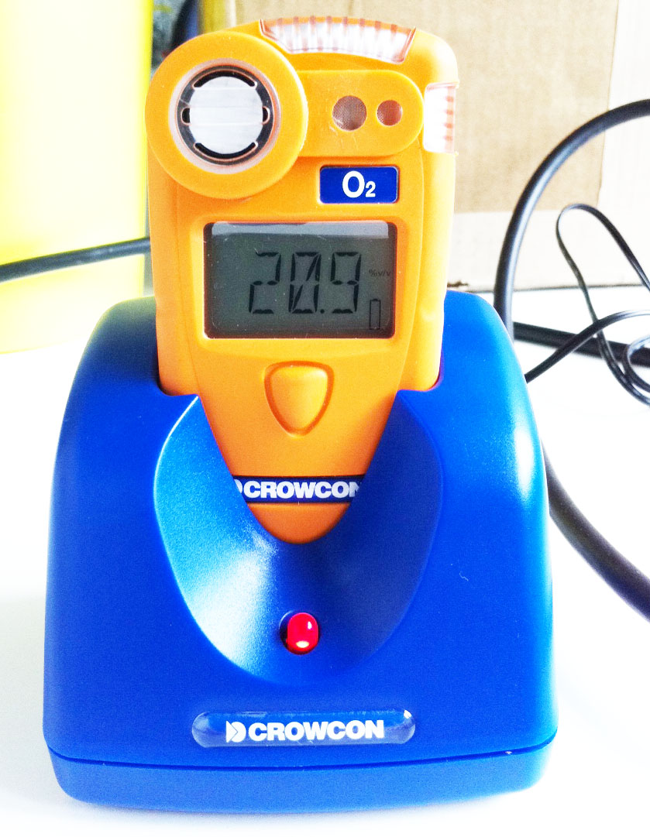
Working with liquid nitrogen
Liquid nitrogen is only allowed in the user lab when the portable oxygen monitor is properly turned on. Instructions can be found in the user lab.
The monitor must be turned on before any
liquid nitrogen is brought to the user lab.
An acoustic signal indicates that the oxygen
monitor is turned on.
Handling liquid nitrogen?
- Wear cryo-gloves, lab coat and face shield.
- Far from electronic equipment.
- In an open area.
- Do not spill on the floor.
- Dewar vessels must be used.
User lab oxygen monitor under
normal working conditions

Slide 20
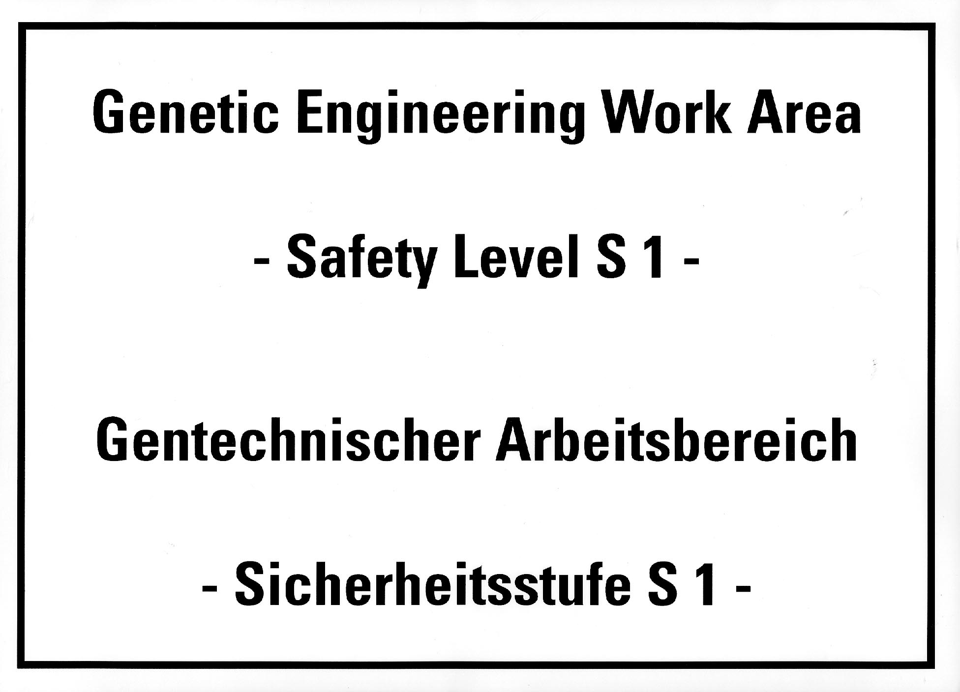
Biological safety
The user lab and SPC laboratories can only be used to prepare biological materials that present no risk to human health and/or the environment (classified as S1). For example, non-infectious, non-virulent, non-toxic, non-prion, non-replicative biological macromolecules.
Before handling intact biological material, you must inform and get the approval of the genetic engineering project leader Maria Garcia Alai.
Organisms, viruses and biological agents presenting a risk to human health and/or the environment (S2 and above) must not be taken into the user lab or SPC facility!
S2 S3 S4

Slide 21
The biological risk groups
Group S1: No Risk to health or the environment.
Purified recombinant gene products (e.g., proteins) produced using S1 organisms that are as safe as the S1 expression host (that are not virulence factors).
S1 expression organisms include laboratory strains of E. coli (E. coli Bl21), yeast (S. cerevisiae and P. pastoris) insect cell lines (Sf9/baculovirus) and HeLa cells.
Please contact the SPC staff if you are working with proteins purified from:
Risk group S2: Little Risk to health or the environment.
Recombinant gene products, virulence factors or genes of unknown function that are expressed using an S1 host, but are originally derived from an S2-S4 organism.
Recombinant gene products that are expressed and purified from an S2 host, even if the gene product is S1 (e.g., S1 proteins expressed in Mycobacterium smegmatis .)
Organisms and viruses which may affect health, cause disease or negatively impact the environment.
Banned from the SPC and User lab:
Risk group S3: Moderate Risk and Risk group S4: High Risk.
Organisms, viruses, or biotoxins which may/will affect health, cause disease, death and/or will negatively impact the environment.

Slide 22
Additional S1 safety procedures
Keep aerosols to a minimum – avoid vigorous handling, shaking or squirting of solutions that contain biological material.
Keep storage vessels, tubes, containers, etc. closed when not in use.
Keep the laboratory windows and doors closed.
Never touch taps or door handles with a gloved hand.
Disinfect spills with 70% v/v ethanol.
Place contaminated waste from cell lysates in an autoclave bag for inactivation.
After completing work:
  Wash and potentially disinfect hands in the sink.
  Disinfect all surfaces (use 70% ethanol for smaller surfaces <2m²).
  Disinfect all materials that have come into contact with biological material.
Please note: The autoclave should be operated by members of staff only.

Slide 23
SPECIAL COVID-19 SAFETY MEASURES
Visitors must register with their name and length of stay at EMBL in a self-declaration form. The contact details will be kept for four weeks.
Hands must be disinfected upon arrival. During the day, wash your hands frequently and thoroughly with soap and water or use an alcohol-based hand disinfectant.
It is important to maintain at least 1.5 m physical distance between yourself and others, wherever possible.
In general, it is obligatory to wear a face mask. FFP2 masks must be worn if the work to be performed does not allow the required physical distance of at least 1.5 m to be maintained at all times. EMBL will also provide FFP2 masks for visitors.
Avoid touching eyes, nose and mouth even when wearing a face mask.
Work surfaces and shared tools must be wiped down with disinfectant upon the completion of work. For this purpose, use 70% ethanol (for small areas) or a commercial surface disinfectant provided by EMBL.
The maximum number of people allowed to be in the same room at the same time in the laboratories are based on a bookable system implemented by EMBL. Users need to book the instrument and bench allocated to the calendar. For further information, pleasereach out to SPC.

Slide 24
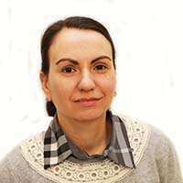


Safety advisors and contacts
Safety responsible for the SPC facility and senior safety advisor:
Maria Garcia - building 48e, room L105, Tel. 040-89902-145, email: garcia@embl-hamburg.de
Safety contact for the derivative laboratory:
Isabel Bento - building 48e, room L147, Tel. 040-89902-155, email: i.bento@embl-hamburg.de
Safety contacts for the user laboratory:
Cy Jeffries - (SAXS) building 25a, room 310, Tel. 040-89902-189, email: cy.jeffries@embl-hamburg.de
Latest safety information available at http://www.embl-heidelberg.de/LocalInfo/SafetyOffice/
Maria Garcia
Isabel Bento
Cy Jeffries

Slide 25
You have come to the end of the online briefing
Please respond to the questions on the subsequent slides.
You will need to answer all questions correctly to pass.

